Slide 1




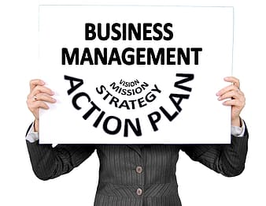


Business Education

Slide 2


Accounting—First Year
College DUAL CREDIT (3 Credit Hours) Vincennes University)
2-semester course
No prerequisites
A MUST for ALL College Business Majors: Excellent foundation for college accounting
Computerized, hands-on approach
Prerequisite for Advanced Accounting
Grades 10, 11, 12

Slide 3

Advanced Accounting
Highly recommended for students who are planning to major in business management, marketing, entrepreneurship, finance or any other business major
Over 60% of Carmel High School students pursue a major in business YOU NEED ACCOUNTING TO BE SUCCESSFUL IN COLLEGE ACCOUNTING
Starting salaries for accountants grow every year and the job outlook is limitless
Accounting 1 prerequisite
Grades 11, 12

Slide 4
Business Law & Ethics
Learn the basics of law
Create an understanding of how the law affects businesses and everyday life
Focus on “why” and “how”
Focus on practical, not theoretical
College Dual Credit through Ivy Tech
Mock trials during class
Prerequisites: Desire to learn and better yourself, HAVE FUN
See Mr. Browning (F102) with any questions
Grades 11, 12

Slide 5

IB Business Management 1-2 & 3-4
Fully Weighted Course that can be used for the SENIOR SCHEDULE
Can be taken for ONE or TWO years 🡪 Exam taken @ end of year 2
Passing Exam Score = Up to 8 college credits at schools like IU
Perfect class for students who want to study business in college
IB 1-2: Grades 11, 12
IB 3-4: Grade 12
CONTENT
Marketing, Finance, Human Resources, Operations
LEARNING STYLE
Project-Based, Authentic Experiences, Class Discussions

Slide 6
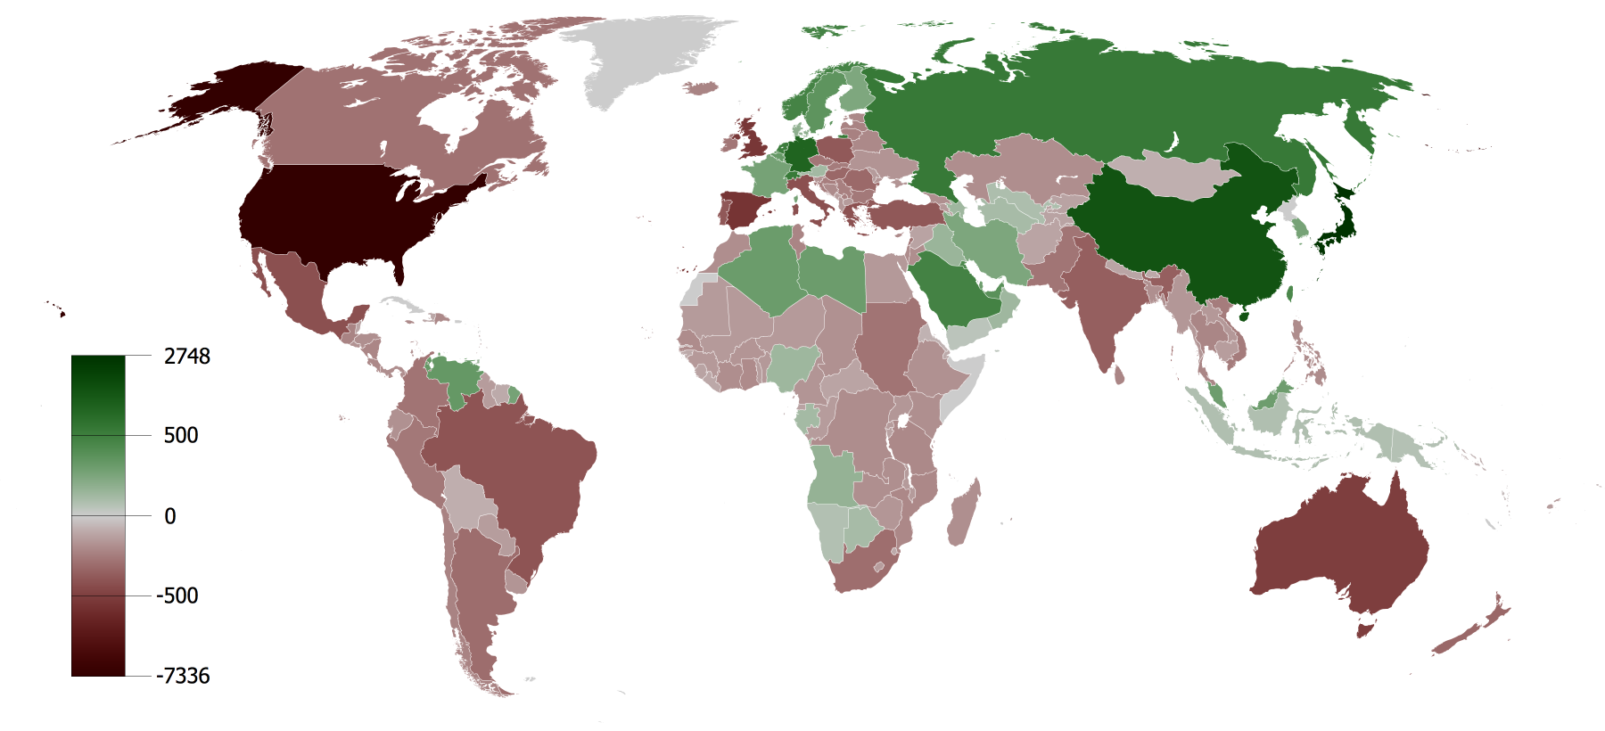
Global Economics
General Economics curriculum includes basic micro and macro economics
Fulfills economics requirement
Homework is primarily studying for tests
Grades 11, 12

Slide 7

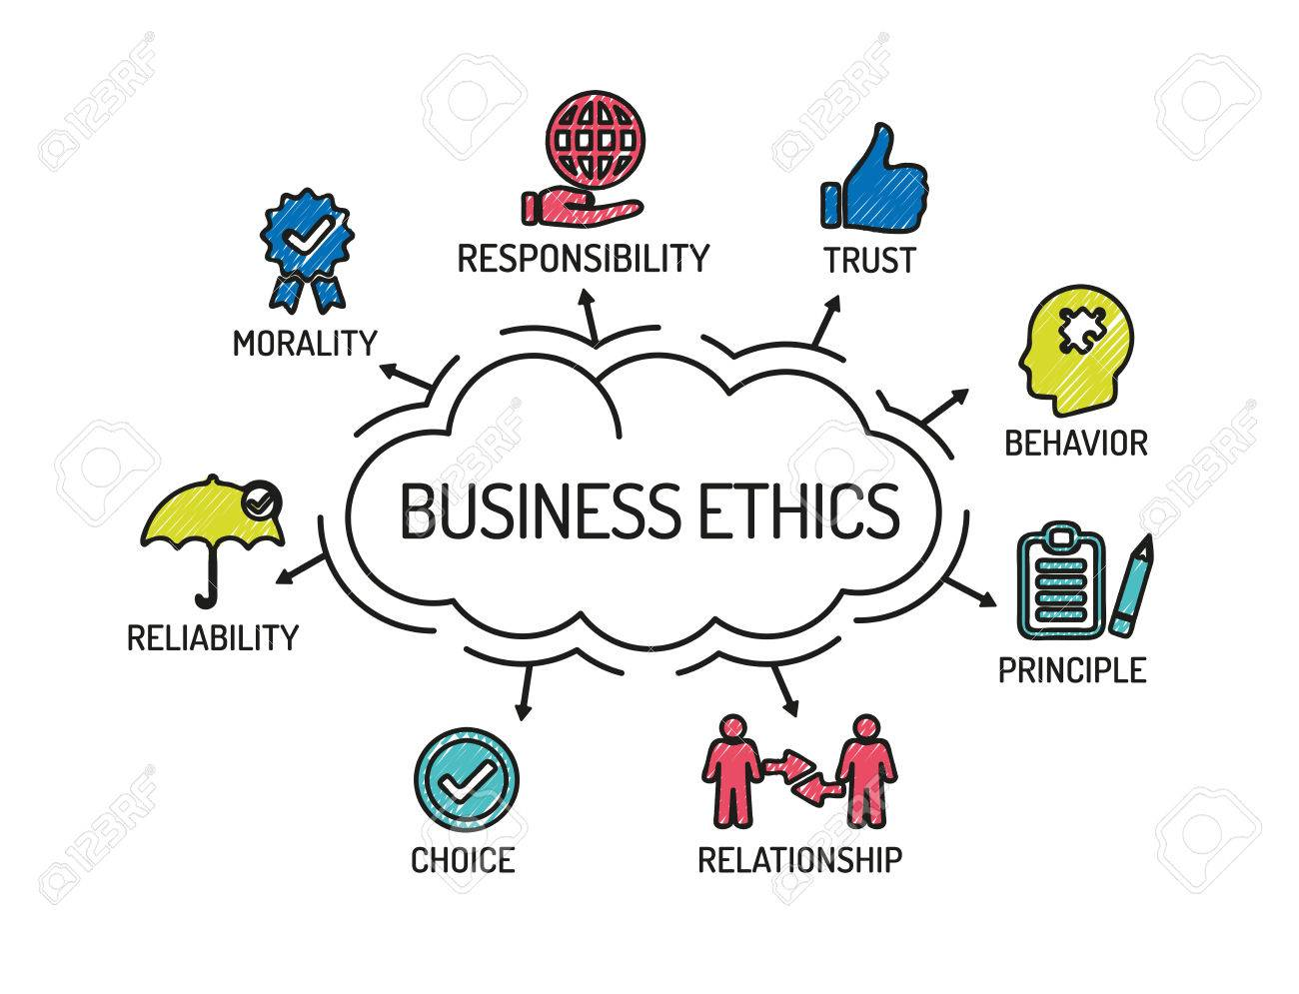

Introduction to Business
Learn More About the Business World
Perfect elective for students with an aptitude for business!
Basic business concepts of management, marketing and entrepreneurship are covered!
Hands on creative projects!
One semester
No homework required
No prerequisite
Grades 9, 10

Slide 8

Introduction to Entrepreneurship
Benefits ALL students
Allows students to uncover unique skills and think outside the box
Creates opportunities
Instills confidence
Project based
Unlimited fun and excitement
Any questions see Mr. Holman
Grades 9, 10

Slide 9
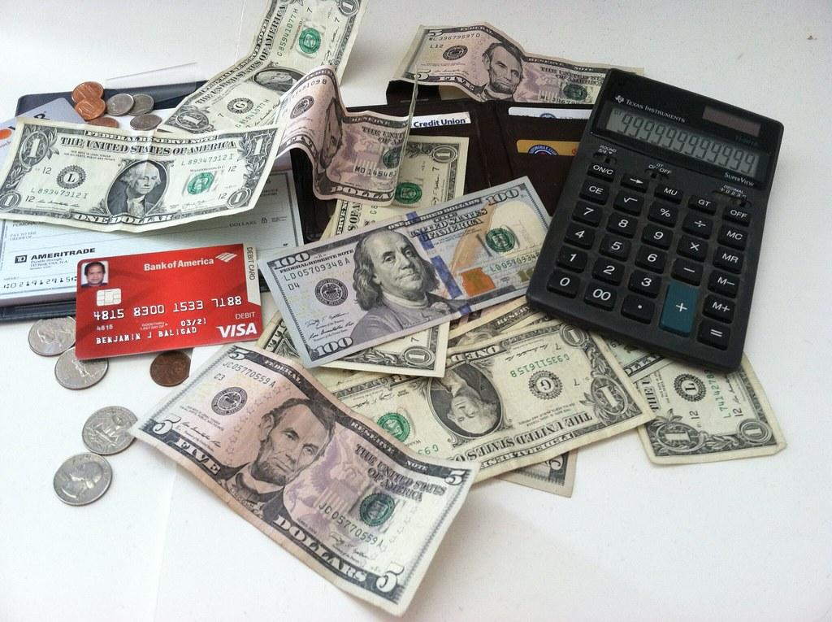
Personal Finance
Great Course for ALL Students
Areas of Study
Financial Goals
Taxes
Banking
Paying for College
Credit
Investing
Insurance
Budgeting
Class Requirements
One semester
Project-based assessments
Grades 11, 12

Slide 10
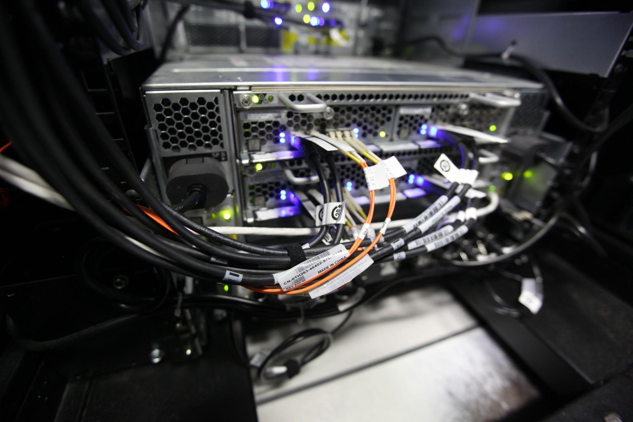

Information Technology / Computer Courses

Slide 11

Introduction to Computer Science
Explores the world of Computer Science
Focus:
Web page development
Programming
Gaming/mobile development
Artificial intelligence/robotics
Hands on!
Grades 9, 10, 11, 12

Slide 12


AP Computer Science Principles
Suited to students who want to explore different areas of Computer Science
Internet
Coding
Computers In Society
College Board approved, accessible course, created to promote understanding of Computer Science
Collaborative, hands-on
Prerequisite - Algebra 1
Full Weight Course
Grades 10, 11, 12

Slide 13
AP Computer Science A
Emphasizes the object-oriented programming methodology
problem solving
algorithm development
coding in the Java language
Equivalent of a first-semester college course in computer science
Rigorously paced course
Prerequisite - Algebra 2
Full Weight Course
Grades 10, 11, 12

Slide 14

Cybersecurity PLTW
Computer Science III Capstone
Career exploration in Cybersecurity / Information Security
Personal, System and Network Security
Applied Cyber Security
Hands-on Projects inside Virtual Machines
Project Lead The Way Course
Prerequisite - AP Computer Science Principles or AP Computer Science A
Full Weight Course
Grades 10, 11, 12

Slide 15
Digital Applications & Responsibility 1 & 2
Focus on Microsoft Office - Word, Excel, PowerPoint, Access
Project based, hands-on, individualized training
Microsoft Office Specialist (MOS) Certification
Dual-Credit through Ivy Tech
3 credit hours if Ivy Tech requirements are met
No Prerequisite (DAR1 is prerequisite for DAR2)
Grades 9, 10, 11, 12

Slide 16
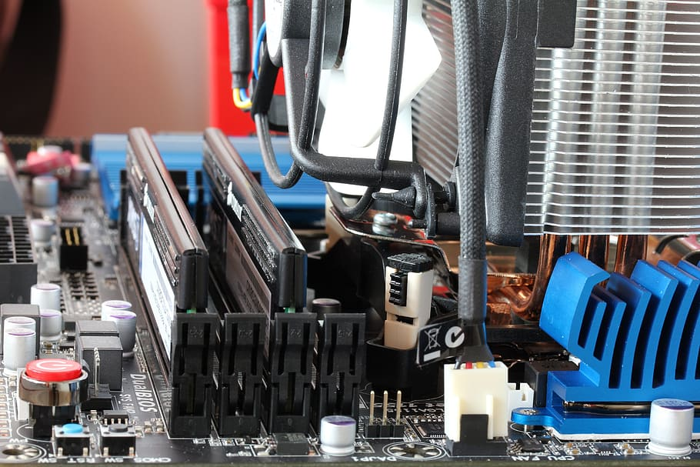
Information Tech Support
Explores Computer Hardware, Networking and Troubleshooting
CISCO Web-Based Curriculum
Computer Assembly
Hardware Requirements
Operating Systems
Windows
Security
Communication
Hands-on Computer Assembly and Troubleshooting
Dual-Credit through Ivy Tech - 3 credit hours Ivy Tech
Full Year Course
Grades 10, 11, 12

Slide 17


Web Design
Web Page Design and Development Class
HTML5/CSS3
Javascript
Develop and design professional web pages
One semester course
Grades 10, 11, 12

Slide 18

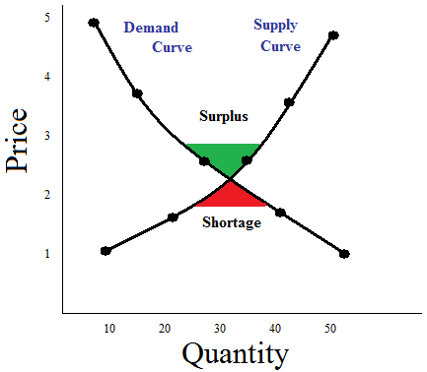
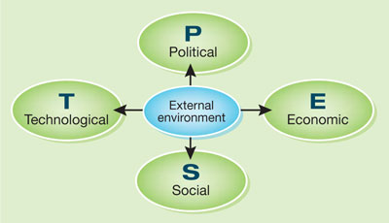
Marketing Courses

Slide 19
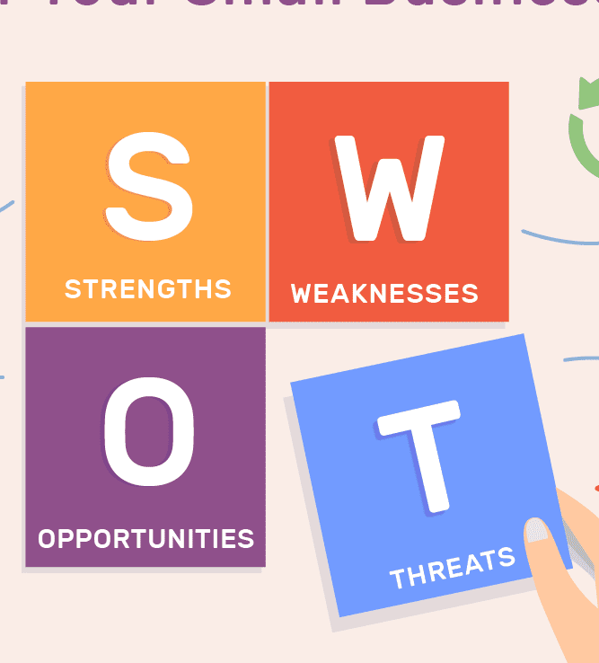
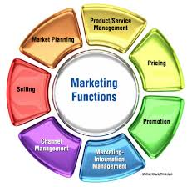
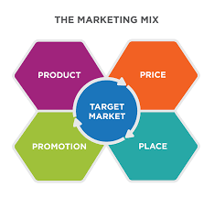
Principles of Marketing 1 & 2
Did you know...marketing is part of your life every day?
Do you like to be creative and collaborative?
Do you like to express your ideas using hands on projects?
Do you think it would be fun to invent a product?
Do you want to be part of the world class Carmel DECA chapter?
Then Principles of Marketing 1 & 2 is the class for you.
No homework
No prerequisite
DECA REQUIRED
Grades 10, 11, 12

Slide 20



Merchandising
Did you know...fashion occurs in a global marketplace?
Do you like to be creative and collaborative?
Do you like to express your ideas using hands on projects?
Do you think it would be fun to create your own “dream store” boutique?
Would you like to create your own fashion designs?
Do you want to be part of the world class Carmel DECA chapter?
Then Merchandising is a class for you!
No homework
No prerequisite
Grades 10, 11, 12

Slide 21


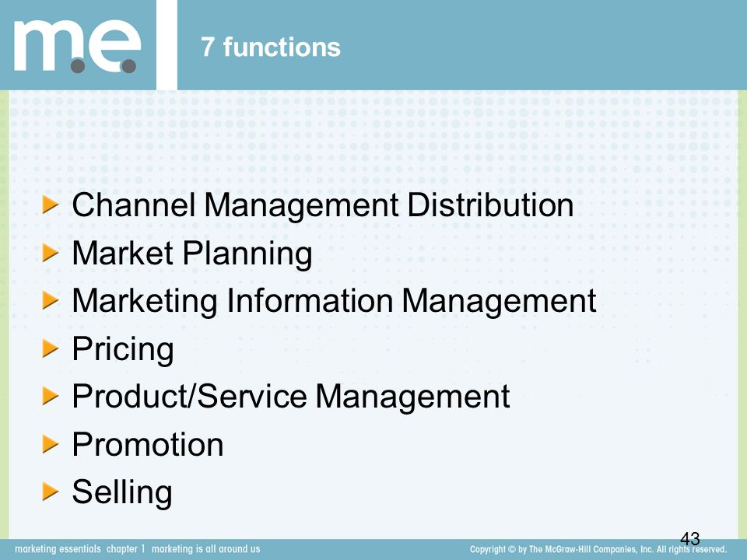
Strategic Marketing
Deca Required
Marketing is part of your life every day
Learn the foundations of marketing and apply the functions of marketing at the advanced level
Study relationships between consumer behavior and marketing activities
Be creative and collaborative?
Express your ideas using hands on projects
World Class Carmel DECA chapter?
No homework is required.
Prerequisite Principles of Marketing or Merchandising or Business Management
Grade 12 only

Slide 22


WBL: Business Cooperative Experiences
Work-based learning experience, career, and leadership development
Release time during B4, G4, or both
Organize Holiday Secret Shop fundraiser
Builds upon the foundations of marketing and applies the functions of marketing at the advanced level.
Would you like to study relationships between consumer behavior and marketing activities?
(Continued NEXT Slide)

Slide 23
WBL: Business Cooperative Experiences (CONT.)
Do you like to be creative and collaborative?
Do you like to express your ideas using hands on projects?
Do you want to be part of the world class
Carmel DECA chapter?
No homework is required.
Prerequisites
Preparing for College and Careers
4 credits of introductory and advanced business courses
Grade 12 Only

Slide 24
Career & Technical Student Organization (CTSO) Leadership in Action
Independent Study course for:
DECA Executive Leadership Team Members President, CMO, COO, CFO, Director of HR, Chief Competition Officers (Work with Mr. Holman)
Carmel Café & Market Managers & Employees Responsible for the strategic planning & daily operations of the Café & Market (Work with Mrs. Noel)
Grades 11, 12
DECA
You must be an active member of DECA to participate in this independent study
LEARNING STYLE
You must be a self-directed & independent learner.
REQUIRED
You must apply for this course.
Pre-approval
by Mr. Holman / Mrs. Noel

